Slide 2
Functional dependencies are to describe the inter-relationship
between attributes in any relation R.
It is denoted by X Y which means Y is functionally
dependent on X.
Y is the dependent and X is the determinant.
Example - Roll no Name is a functional dependency.
Here Roll No. is the determinant and Name is the dependent.

Slide 3
EID
Name
Salary
1
Aditya
10000
2
Manoj
20000
3
Sumit
25000
Functional Dependency: EID Name, Salary
Functional Dependency Chart:-
EID is the primary key here
Name
EID
Salary

Slide 4
Types of functional dependencies
The major types of FD’s-
Partial and Full Functional Dependencies
Transitive and Non-Transitive Dependencies

Slide 5
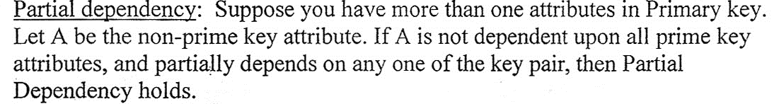
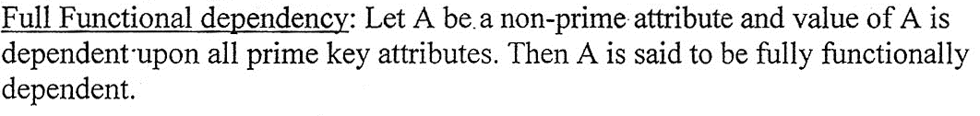
Partial Dependency:
Full Functional Dependency:

Slide 6
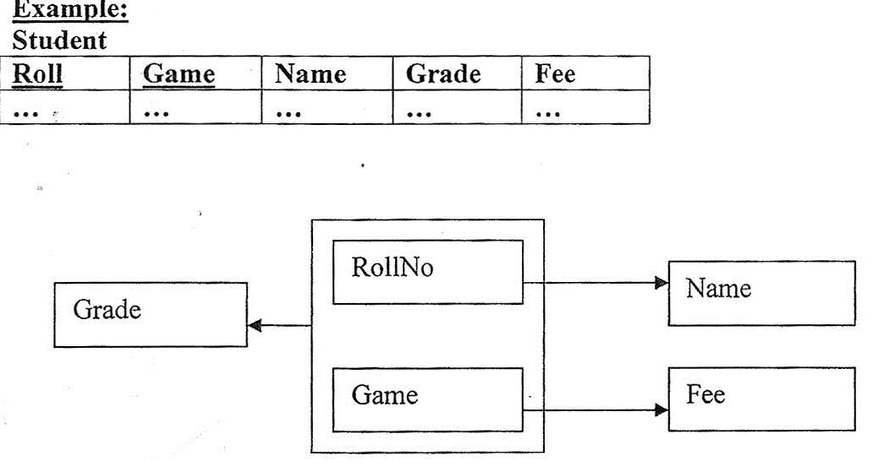
Here Name is dependent only on Roll No. So partial dependency.
Again Fee is dependent only on Game. So partial dependency.
But, Grade is dependent on both Roll No and Game. So Grade is
said to be fully functionally dependent on Roll No and Game.

Slide 7
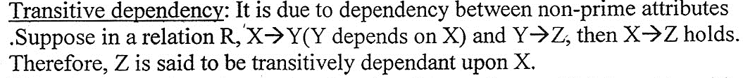
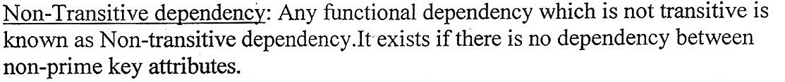
Transitive dependency
Non Transitive dependency

Slide 8
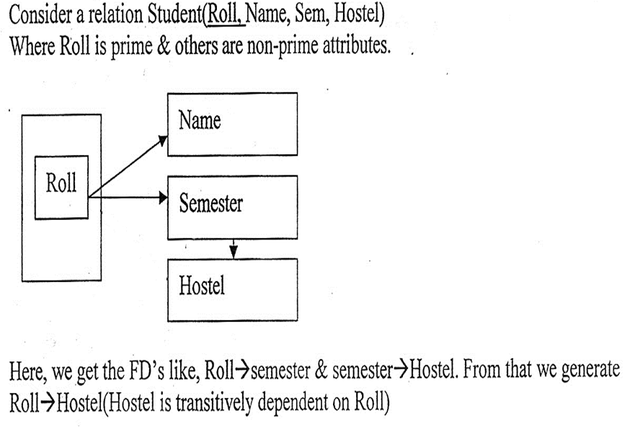

Slide 9
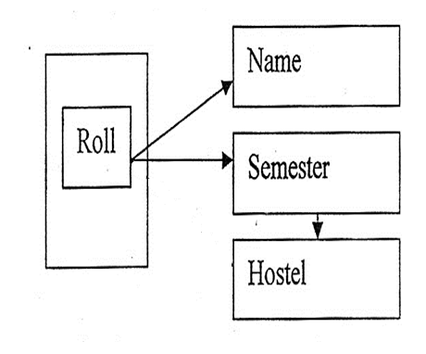

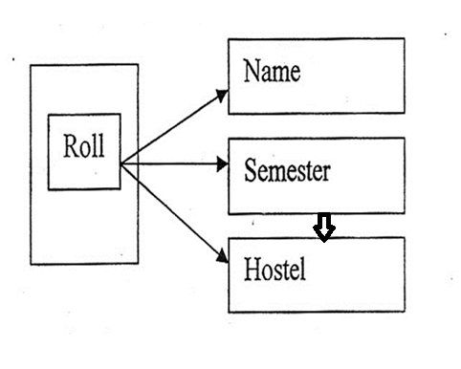
Therefore,

